Slide 1
Variables!
Micro:Bit Lesson 1

Slide 2
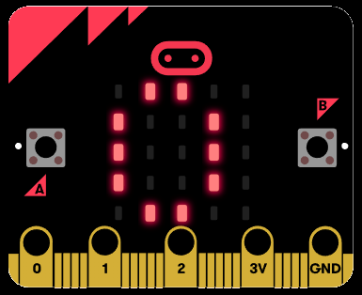
Variables in Micro:Bit
Use let to create variable foo then assign the value 5
Ex:
let foo = 5
basic.showNumber(foo)

Slide 3
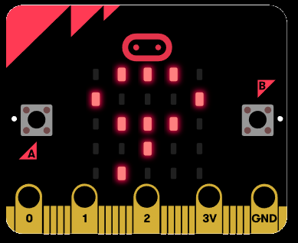
You can change your Variables!
To change a variable, simply reassign another number.
Assign the value 9 to foo
Ex:
let foo = 5
foo = 9
basic.showNumber(foo)

Slide 4
Conditionals!
Micro:Bit Lesson 2

Slide 5
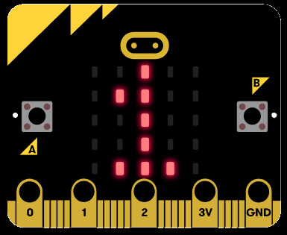
Conditionals in Micro:Bit
A conditional is something that looks for either true or false
Ex:
let foo = 5;
if (foo == 5){
foo = 1;
} else {
foo = 9;
}
basic.showNumber(foo)

Slide 6
Loops!
Micro:Bit Lesson 3

Slide 7
There are two types of loops

Slide 8
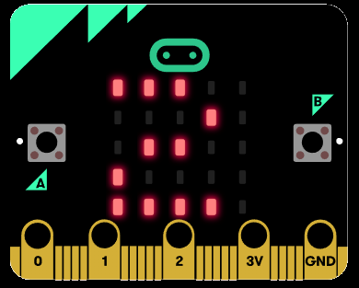
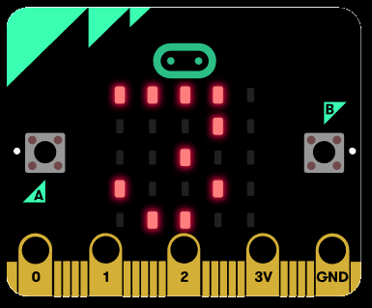
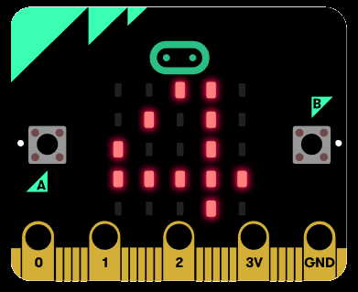
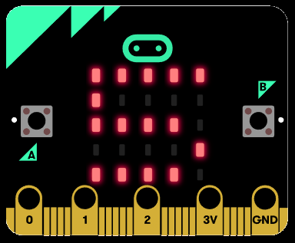
For Loops in Micro:Bit
A for loop will run until the condition in the middle is met (Note: will re-write this later)
Ex:
let i = 0
for (i = 0; i < 5; i++) {
basic.showNumber(i)
}

Slide 9
While Loops in Micro:Bit
A while loop will run until the condition is not true (Note: will re-write this later)
Ex:
let foo = 0
while (foo < 5) {
foo = foo + 1
basic.showNumber(foo)
}

Slide 10
I/O!
Micro:Bit Lesson 2

Slide 11
I/O in Micro:Bit
I/O stands for input and output. This is how you will interface with your Micro:Bit. One way you can input information to the Micro:Bit is through Pins.

Slide 12
What are pins?
You can think of a pin like a light switch. It can be either ON or OFF.
ON = 1
OFF = 0

Slide 13
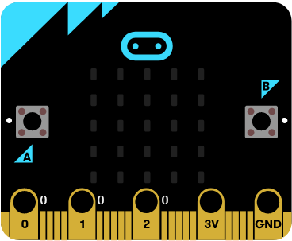
Where are the pins?
There are 4 main pins on your Micro:Bit. They are located at the bottom of the machine.
Pin 1
Pin 2
Pin 3
Ground Pin

Slide 14
How to use a pin
You can turn a pin ON by holding the GND pin and touching either of the three pins.

Slide 15
Change pin 1 to ON
You can turn pin 1 ON by holding the GND pin and touching pin number 1.

Slide 16
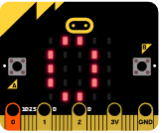
Pin 0 code
Ex:
Let foo0 = 0
input.onPinPressed(TouchPin.P0, function () {
basic.showNumber(foo0)
})

Slide 17
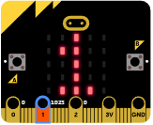
Pin 1 code
Ex:
Let foo1 = 1
input.onPinPressed(TouchPin.P1, function () {
basic.showNumber(foo1)
})

Slide 18
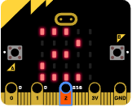
Pin 2 code
Ex:
Let foo2 = 2
input.onPinPressed(TouchPin.P2, function () {
basic.showNumber(foo2)
})

